Slide 1

NeuroForge
Enterprise Software Lifecycle and DevOps Management System
MILESTONE 1
Notes:
Title slide. Replace the four bracketed fields with your team names, guide, organization and submission date.

Slide 2


Introduction
Purpose
Scope
NeuroForge is an AI-powered platform that automates and manages the complete Software Development Life Cycle — requirement gathering, planning, design, coding, testing, deployment, monitoring and maintenance — inside a single integrated workspace. Its purpose is to replace the disconnected tool-chain most engineering teams rely on today with one centralized environment in which every stage is assisted by AI and every artefact remains traceable back to the requirement that produced it.
The platform supports project teams from requirement capture through implementation, testing, deployment and long-term maintenance. It covers role-based access for nine user types, AI-assisted code and documentation generation, automated testing and bug tracking, CI/CD orchestration, real-time analytics dashboards and performance monitoring. The goal is to reduce manual effort and shorten delivery time while keeping the process structured, auditable and traceable.
NeuroForge Enterprise SDLC Platform
2

Slide 3


Problem Statement
Enterprise teams manage requirements, design, coding, testing and deployment in separate disconnected tools — which slows delivery and multiplies errors.
Current state
With NeuroForge
A fragmented tool-chain
One integrated workspace
Requirements live in documents, tasks in a tracker, code in Git, tests in a fourth tool
Every SDLC stage in one platform with a shared data model
Manual hand-offs between analysts, developers, testers and DevOps
AI converts requirements into user stories, test cases and code suggestions
No traceability from a requirement to the code and tests that satisfy it
End-to-end requirement-to-code-to-test traceability maintained automatically
Defects surface late, after integration, when they are costliest to fix
Continuous analysis and automated testing catch defects early
Progress reporting is assembled by hand from several sources
Real-time dashboards report progress without manual consolidation
NeuroForge Enterprise SDLC Platform
3

Slide 4
User Types
Nine roles, each with a scoped set of permissions and responsibilities.
1
System Administrator
2
Project Manager
3
Business Analyst
Creates accounts, assigns roles and permissions, configures settings and monitors system health.
Plans projects, builds schedules, assigns tasks, tracks progress and manages resources to ensure on-time completion.
Collects and analyses stakeholder requirements and prepares documents aligned to business objectives.
4
Product Owner
5
Software Architect
6
Developer
Defines the product vision, prioritises the backlog and approves requirements to maximise delivered customer value.
Designs system architecture, selects technologies and defines standards for scalability, security and maintainability.
Builds features, writes and reviews code, fixes defects, integrates APIs and uses AI assistance.
7
QA / Test Engineer
8
DevOps Engineer
9
Client / Stakeholder
Creates and runs manual and automated tests, logs defects, verifies fixes and enforces quality.
Manages CI/CD pipelines, automates builds and deployments and monitors infrastructure health.
Reviews progress on dashboards, approves deliverables and confirms the software satisfies business requirements.
NeuroForge Enterprise SDLC Platform
4

Slide 5
Functional Requirements
Nine core modules delivered by the platform.
1
Authentication & Role-Based Access Control
6
Automated Testing & Bug Tracking
Secure login with permissions scoped by role, so users reach only authorised modules.
Executes test cases, identifies defects and centralises reporting and bug tracking.
2
Requirement Gathering & Project Planning
7
CI/CD Pipeline for Build & Deployment
Create, prioritise and track requirements; plan milestones, sprints and resources.
Automates build, test and deployment for faster and more reliable releases.
3
Task Assignment & Sprint Management
8
Dashboards, Reports & Project Analytics
Assign tasks, set deadlines and run Agile sprints on Scrum or Kanban boards.
Live views of progress, sprint status, productivity, defects and deployments.
4
AI-Assisted Code Generation & Documentation
9
Performance Monitoring & Maintenance
AI drafts code snippets, recommends solutions and writes technical documentation.
Monitors application performance, server health, resource use and system logs.
5
Git Integration & Version Control
Branching, version tracking, pull requests, merges and review on connected repos.
NeuroForge Enterprise SDLC Platform
5

Slide 6




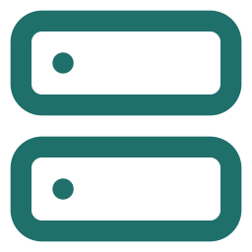

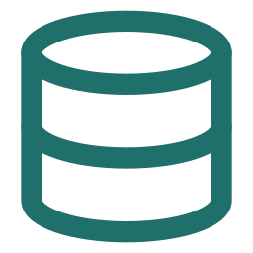
System Architecture
Modular, microservices-inspired — five core components
User
React Frontend (Presentation Layer)
REST API Layer
Security
Spring Boot — Service Layer / Business Logic
AI Engine
Spring Security + JWT + RBAC
LLM-based analysis & insights
Data Layer — MSSQL (SSMS)
A layered stack — from user interface down to data, with AI woven through the middle.
API Layer
Service Layer
Data Layer
AI Engine
Frontend
NeuroForge Enterprise SDLC Platform
6

Slide 7

Technology Stack
Frontend
Backend
React.js
Spring Boot
Database
DevOps
MSSQL (SSMS)
Jenkins, Docker, Kubernetes
AI
LLM APIs
NeuroForge Enterprise SDLC Platform
7

Slide 8
Use Case Diagram
How each of the platform's user roles interacts with the system.
A use case diagram maps the functional scope of a system by showing actors (users or external systems) and the actions, or “use cases,” available to them.
In this project, it captures how all nine user roles — from Business Analyst to DevOps Engineer — engage with the platform's core capabilities, from requirements to deployment.
It highlights where the AI Engine supports human tasks, such as generating user stories, suggesting architecture, and writing test cases, through «supports» relationships.
It also documents «include» and «extend» relationships, showing mandatory sub-steps and optional exception flows like bug reporting.
Together, it gives stakeholders a single reference for who can do what within the system, grounding requirements discussions and access-control design.
8

Slide 9
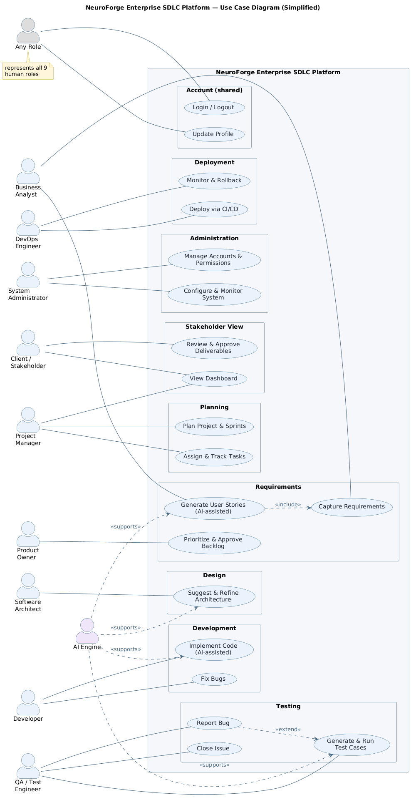
Use Case Diagram
9

Slide 10
Class Diagram
The structural blueprint of the platform's core domain objects.
A class diagram models a system's static structure: its classes, their attributes and operations, and the relationships between them.
It shows how all nine user roles specialize from a shared User class, inheriting login, logout, and profile management.
It defines the core domain entities — Project, Requirement, UserStory, Sprint, Task, Repository, TestCase, Bug, Deployment — and how they connect across the project lifecycle.
The AIEngine class and its «supports» dependencies show exactly where AI-generated suggestions plug into human-owned workflows.
This diagram is the reference used to design the database schema and the application's object model.
10

Slide 11
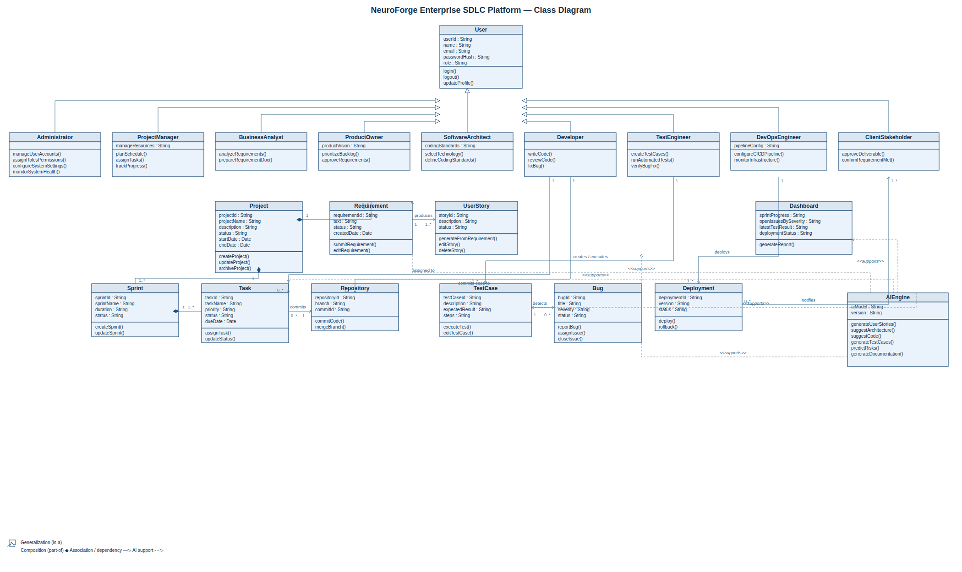
Class Diagram
11

Slide 12
Sequence Diagram
How a request travels through the roles and the AI Engine over time.
A sequence diagram shows the order of messages exchanged between actors and system components for a specific scenario, read top to bottom as a timeline.
It traces one full delivery cycle: from a client providing requirements, through AI-assisted user story drafting and architecture suggestion, to coding, testing, and deployment.
Dashed return arrows mark AI-generated suggestions that always require human review and acceptance before work proceeds.
The alt block captures the bug-fix loop, showing how a failed test triggers a report, a fix, and a retest before approval.
It gives the team a shared, unambiguous picture of collaboration and hand-offs across roles, useful for spotting bottlenecks or missing steps.
12

Slide 13
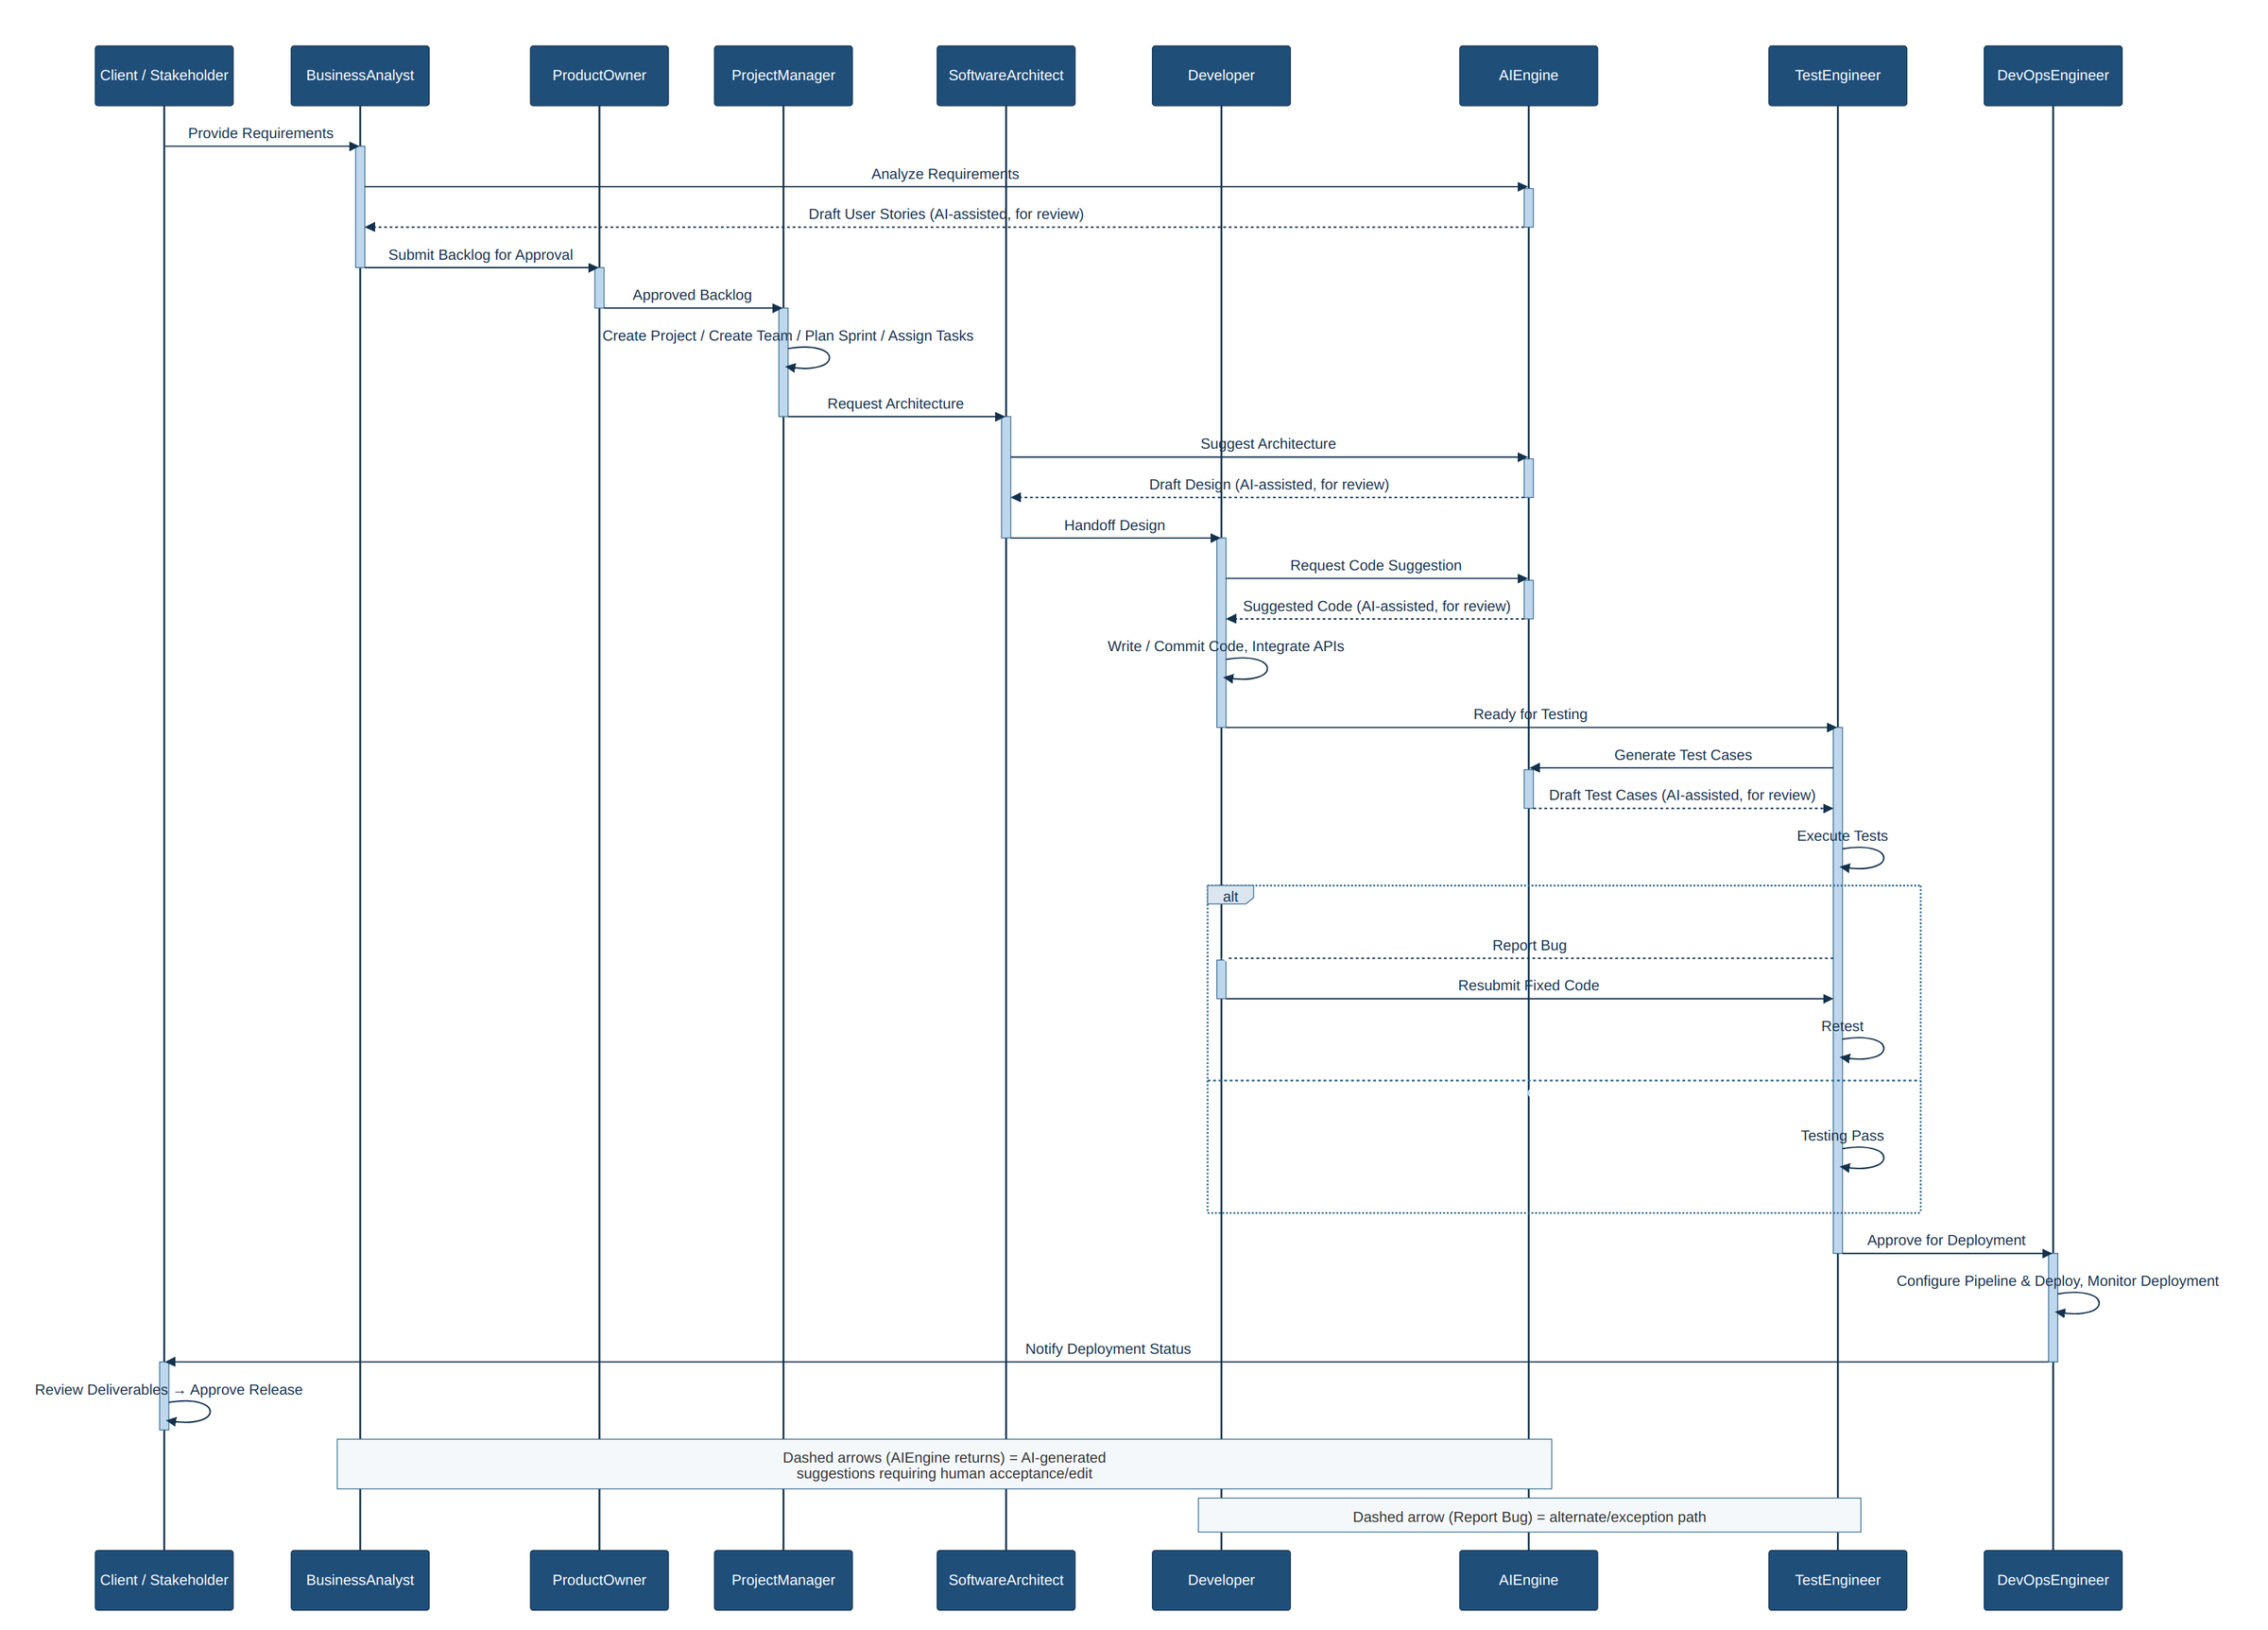
Sequence Diagram
13

Slide 14
Activity Diagram
The end-to-end workflow from login to release, phase by phase.
An activity diagram models workflow logic — the sequence of actions, decision points, and looping paths a process can take.
It lays out the full SDLC as a swimlane flow: Authentication, Planning, Design, Development, Testing, Deployment, and Maintenance.
Decision diamonds capture real branching logic, such as invalid login retries, bug-found loops, and rollback-on-failure during deployment.
AI-assisted steps are visually distinguished, showing exactly where automation feeds into each phase before a human reviews or approves the result.
It is the primary reference for onboarding new team members to how work actually moves through the platform.
14

Slide 15
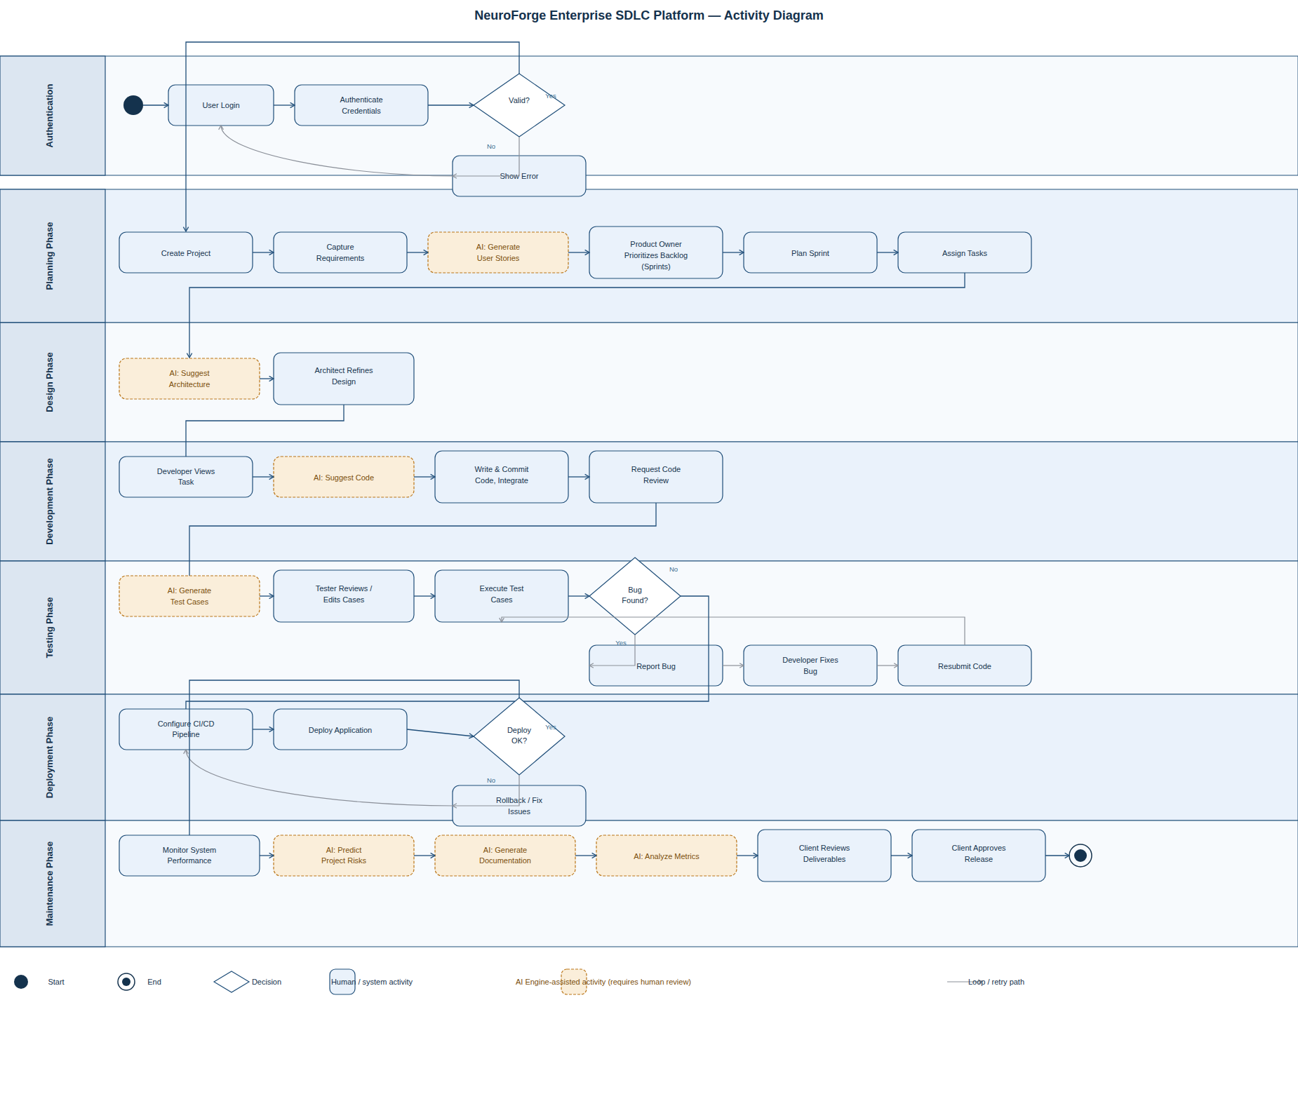
Activity Diagram
15

Slide 16
ER Diagram
The relational database structure behind the platform.
An entity-relationship diagram documents a database's tables, their columns, and the keys and relationships that connect them.
It defines every core table — Projects, Users, Requirements, UserStories, Tasks, Sprints, TestCases, Bugs, Deployments, and more — with primary and foreign keys.
It captures audit and traceability fields, such as CreatedByUserID, ModifiedAt, and RowVersion, applied consistently across tables for accountability and concurrency control.
Role-based access is modeled explicitly through Roles, RolePermissions, and ProjectMembers, tying permissions to modules and projects.
This diagram is the direct source for generating and reviewing the physical database schema.
16

Slide 17
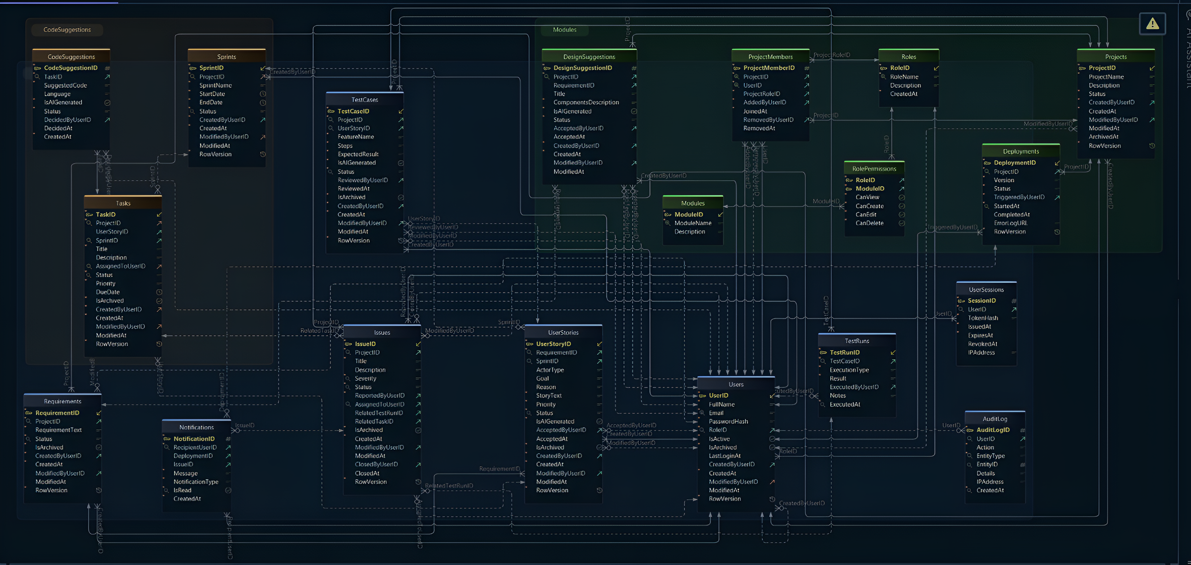
ER Diagram
17

Slide 18
Conclusion
NeuroForge brings the full Software Development Life Cycle into a single governed workspace and applies AI at every stage of it. Requirements become user stories, user stories become code and test cases, and every build is deployed, monitored and traced back to the requirement that produced it — with less manual effort, fewer late defects and complete visibility for the whole team.
Thank you
NeuroForge Enterprise SDLC Platform
18

